Slide 1
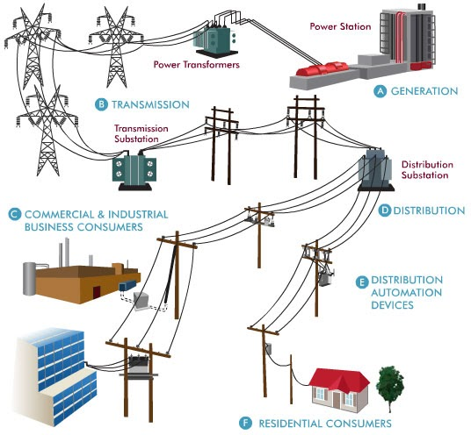
Grid Connection

Slide 2
Grid Connection
An electrical power grid is an interconnected network that delivers the generated power to the consumers. It is, sometimes, also called as an electrical power system. A power grid consists of generating stations (power plants), transmission system and distribution system.
Transmission of electrical power over longer distances is a lot much economical than the relative transmission of any other fuel.
A hydroelectric plant must be located according to an appropriate dam site or a wind power plant may be located off-shore to harvest additional energy from the wind.
Thus, a long distance transmission system is needed to transmit the generated electricity to the populated areas. A distribution system is needed to distribute the power to every consumer at appropriate voltages.

Slide 3
Grid Connection
An electric power system is a network used to generate, transmit, and distribute electrical energy from power stations to consumers safely and efficiently. The main stages are Generation, Transmission, and Distribution.
A. Generation
Electricity is produced at the power station using sources like wind, or solar.
Generators produce power at medium voltage (typically 11–33 kV). The generators usually produce voltage in the range of 11 kV to 33 kV. Since long-distance transmission at low voltage causes high losses, the generated voltage is stepped up using power transformers.
High voltage reduces current and minimizes transmission losses over long distances.
B. Transmission
Power is carried over high-voltage transmission lines (e.g., 132 kV, 220 kV, 400 kV).
These lines move electricity efficiently across cities and regions.
Transmission Substation: Voltage is stepped down to a lower level suitable for distribution.
Switching, protection, and control operations occur here.

Slide 4
Grid Connection
C. Commercial & Industrial Consumers
Factories, offices, and large buildings receive power (often at higher voltage levels for heavy loads).
D. Distribution
Power flows through distribution lines on poles or underground cables.
Voltage is reduced further (e.g., 11 kV → 415 V).
Distribution Substation: Final voltage conversion happens here and supplies power safely to local areas.
E. Distribution Automation Devices
Devices like reclosers, breakers, and sensors monitor and control power flow.
They detect faults and improve reliability.
F. Residential Consumers
Homes receive low-voltage supply (typically 230 V in India).
Used for lighting, appliances, and domestic needs.

Slide 5
Grid Connection

Slide 6
Power Generation And Transmission
Power Generation:
Electricity is generated in power plants which are often located far away from the populated areas.
There are various types of power generating stations such as thermal, nuclear, hydro, solar, wind etc.
A power plant may consist two or more 3-phase alternators which are operated in parallel.
Electricity is generated in power plants at voltages ranging from 11kV up to 25 kV.
Generation voltage can not be much higher due to technical limitations.

Slide 7
Power Generation And Transmission
Transmission:
For the transmission of power over longer distances, the generated voltages are stepped up to a much higher level.
A step-up transformer is used for this purpose, which increases the voltage level with the corresponding decrease in the current.
Stepping up the voltage is necessary to increase the transmission efficiency by reducing I²R losses in the transmission lines.
Higher transmission voltage means lesser the current and, hence, lesser the I²R loss.
Transmission voltages are generally 220kV or greater up to 765kV.
Transmission lines are often seen running over tall towers on the outskirts of a city.

Slide 8
Power Distribution
Power from the transmission system is then stepped down to a considerably lower voltage (say 33 to 66kV) using a step-down transformer in a primary step-down substation.
The power is then carried to distribution substations or directly to very large industrial consumers.
At distribution substations, the power is further stepped down (say at 11kV).
Power distribution is carried out using overhead or underground distribution lines which are usually interconnected in a ring or mesh network types.
Distribution transformers are used to lower the voltage further to the utilization voltage (120 volts or 230 volts) and supply several consumers using the secondary distribution lines.
This is, however, a general overview of an electric power grid.
But practically, a power grid is much more complex. The voltage levels for transmission and distribution vary widely.

